Slide 1


Quora Question Pair Similarity

Slide 2

TEAM MEMBERS
Chekuri Nikhil
Cinthiya M
Avinash Durugkar
Under the Guidance of Kanav Bansal, Sandhya and Abhilash Patel.

Slide 3
DESCRIPTION
Over 100 million people visit Quora every month, so it's no surprise that many people ask similarly worded questions. Multiple questions with the same intent can cause seekers to spend more time finding the best answer to their question, and make writers feel they need to answer multiple versions of the same question. Quora values canonical questions because they provide a better experience to active seekers and writers, and offer more value to both of these groups in the long term. The main aim of the project is to predict whether a pair of questions are similar or not.

Slide 4
Problem Statement:
Identify which questions asked on Quora are duplicates of questions that have already been asked.
Domain:
Social Network.
Prerequisites:
Python programing language, Machine Learning, NLP and MLOPs.

Slide 5
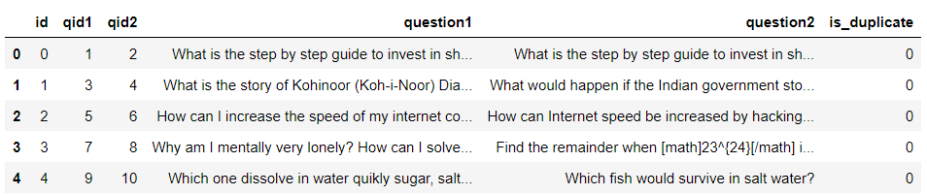
DATASET
Data link:
https://github.com/Koorimikiran369/Quora-Question-Pairing/blob/main/train.csv.zip
Data Overview:
Data will be in a file Train.csv
Train.csv contains 5 columns : qid1, qid2, question1, question2, is_duplicate
Number of rows in Train.csv = 404,290
Data Head:

Slide 6
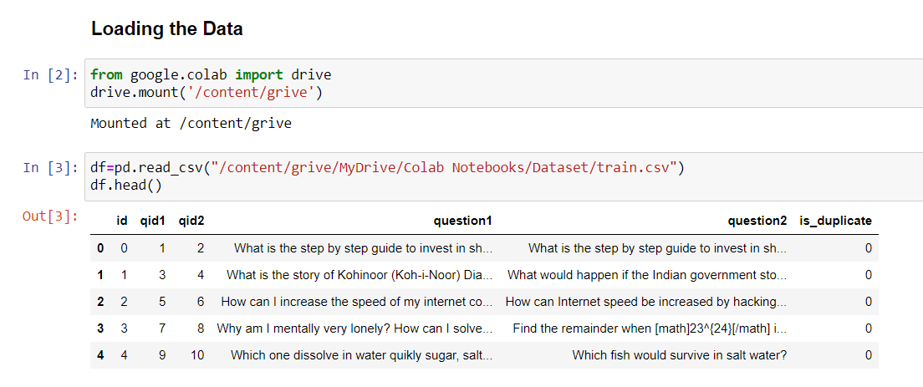
STEPS AND TECHNIQUES THAT ARE USED
Load the Data Set:

Slide 7
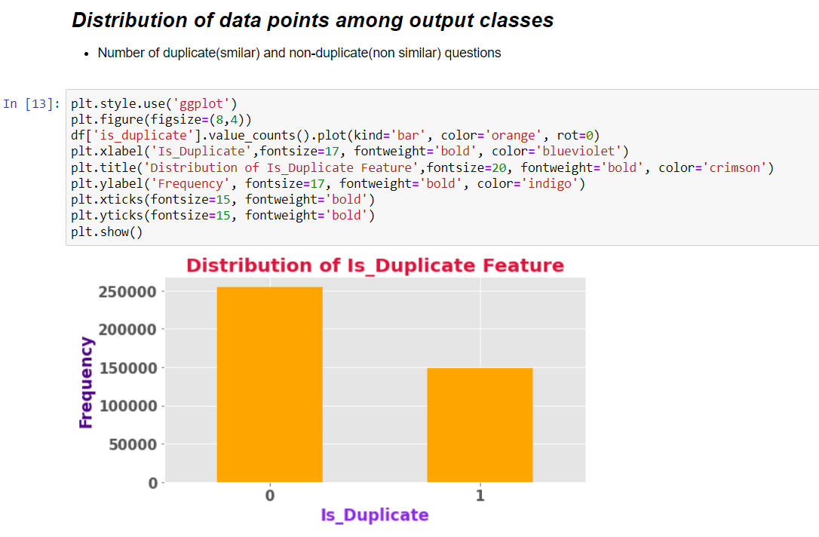
Ratio of Similar and Non-similar questions:
Distribution of Duplicate and No-Duplicate class are imbalanced.

Slide 8
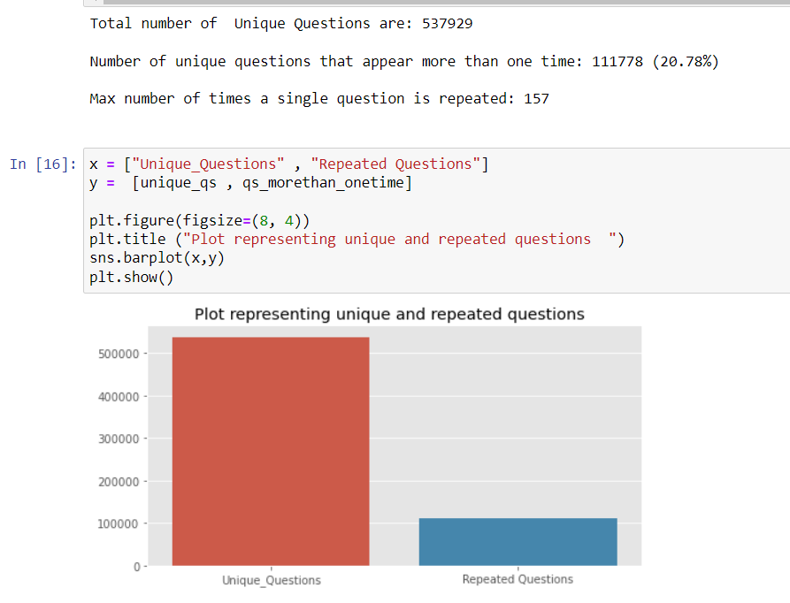
Ratio of Unique Questions and Repeated Questions:

Slide 9
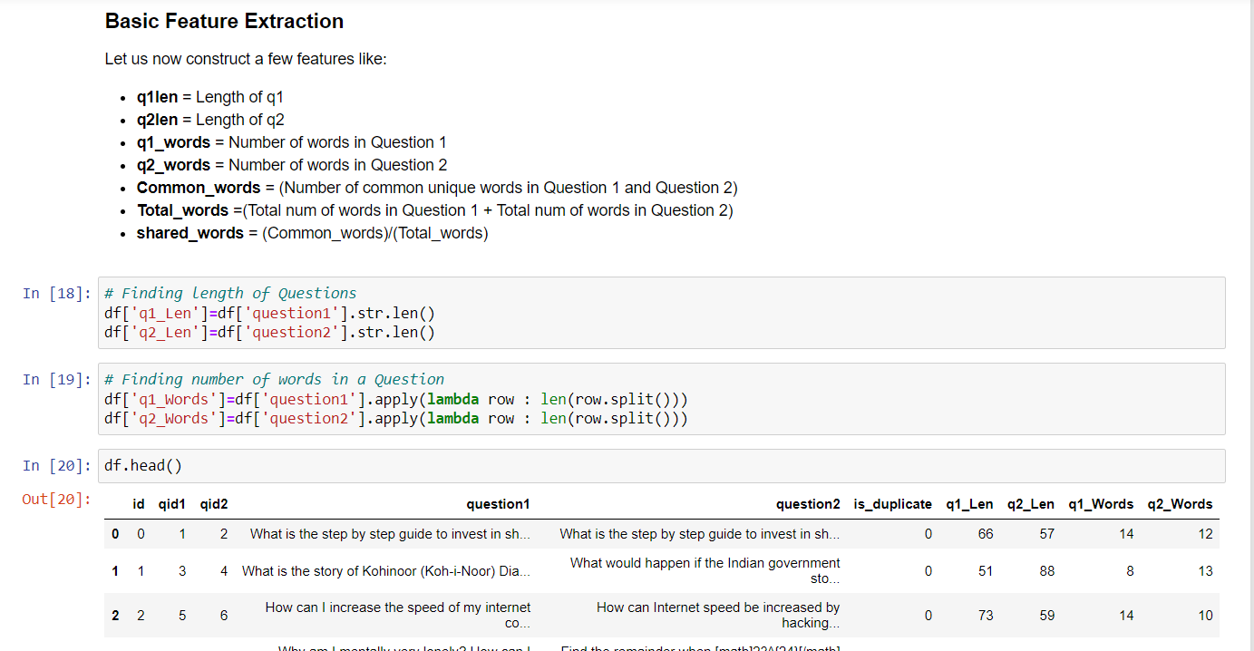
Basic Feature Extraction:

Slide 10
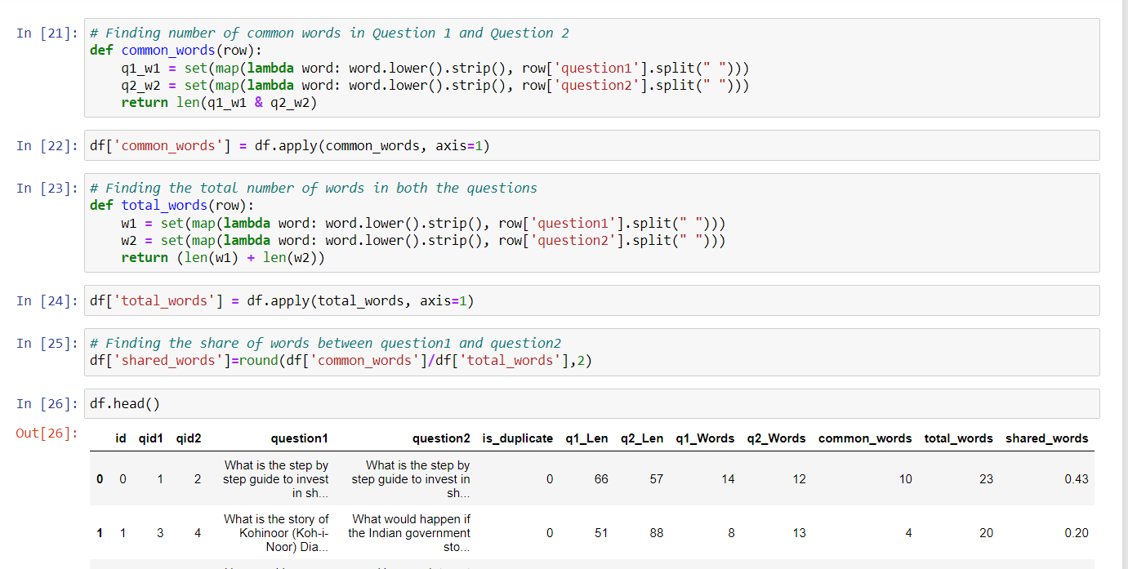
Basic Feature Extraction:
(Continued)

Slide 11
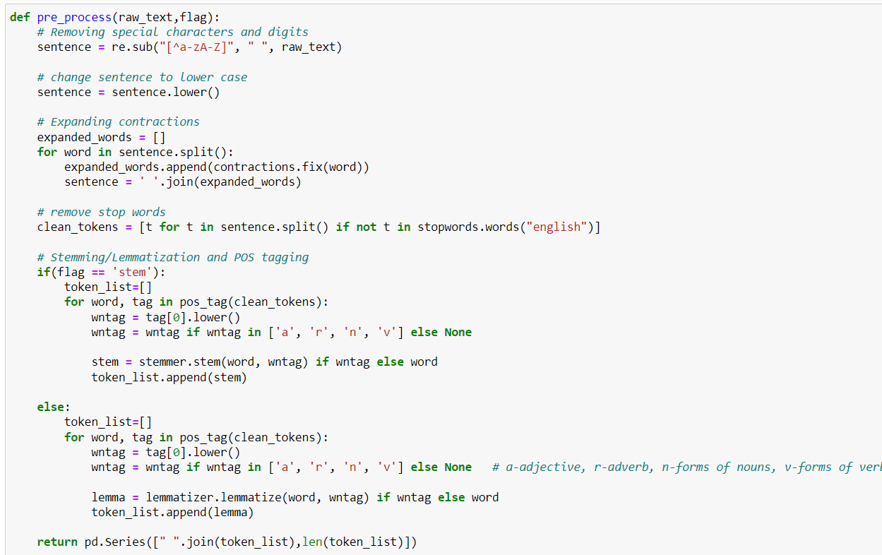
Text Preprocessing, Tokenization, Stemming, POS Tagging, Lemmatization:

Slide 12
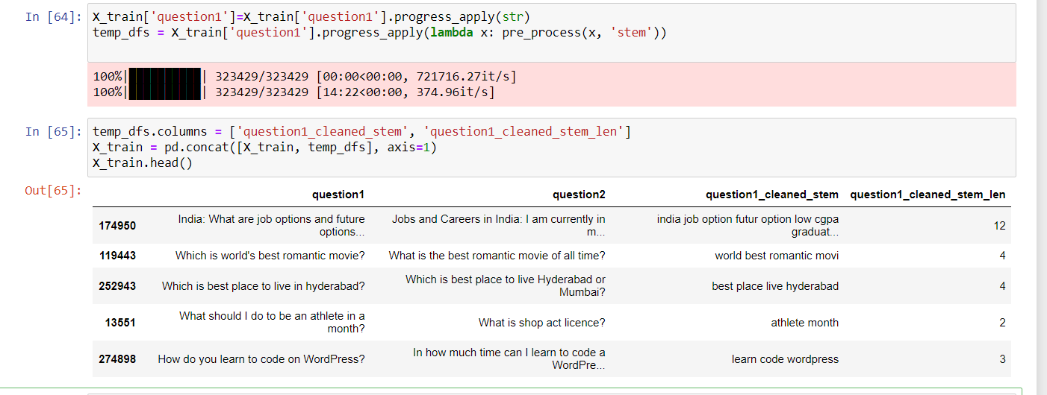
Applying Stemming on Question 1 column train data:
(Similarly applying Stemming for Question 1 column test data and Question 2 column on train and test data).
Repeating the steps for Lemmatization of Question 1 and Question 2 columns on train and test data.

Slide 13
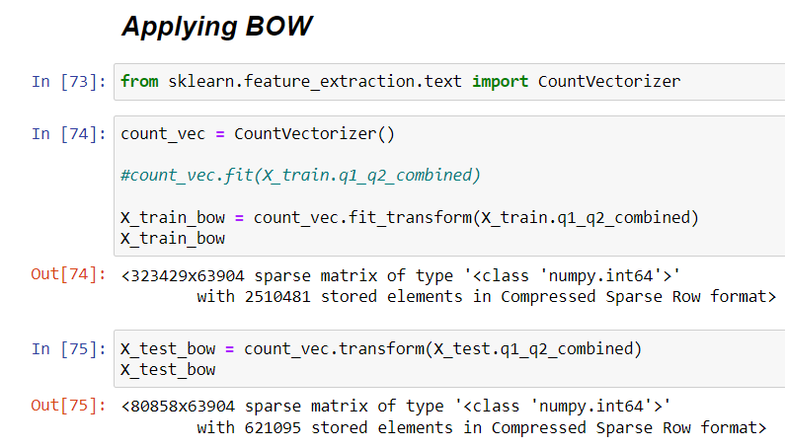
Applying BOW on X_train and X_test data:

Slide 14
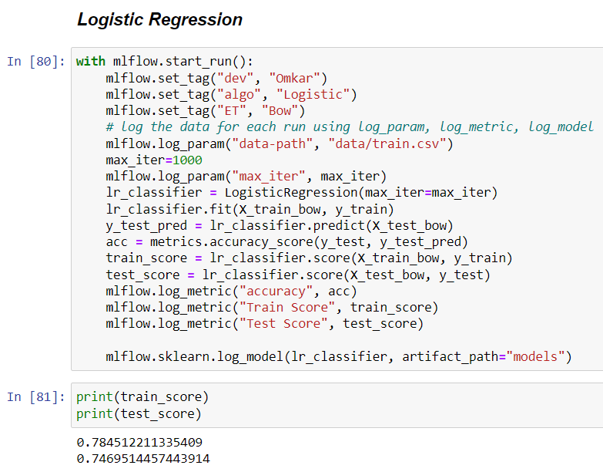
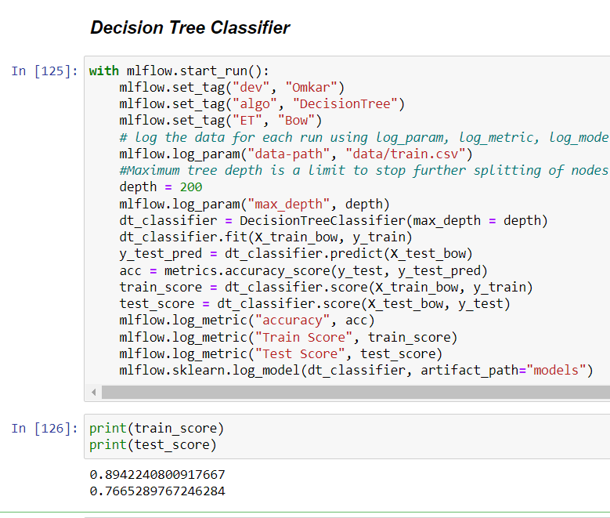
Model building and Model Evaluation with Mlflow using Logistic Regression, Decision Tree, Random Forest and XGBoost algorithms on BOW Vectorization:

Slide 15
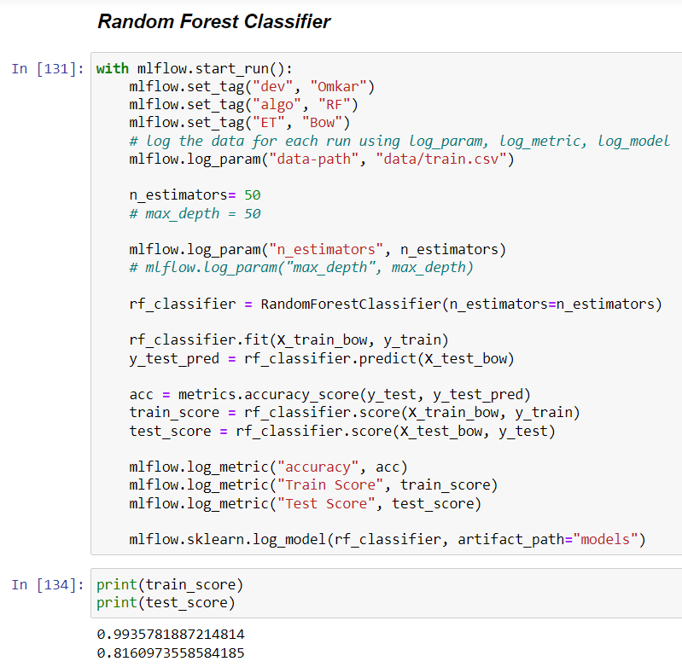
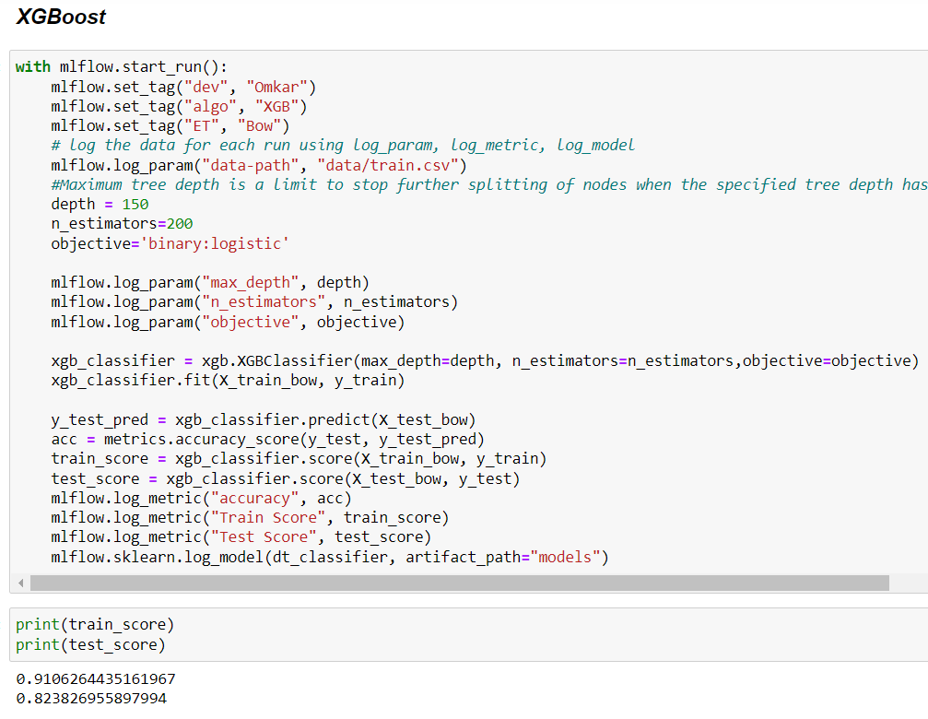
Model building and Model Evaluation with Mlflow using Logistic Regression, Decision Tree, Random Forest and XGBoost algorithms on BOW Vectorization: (continued)

Slide 16
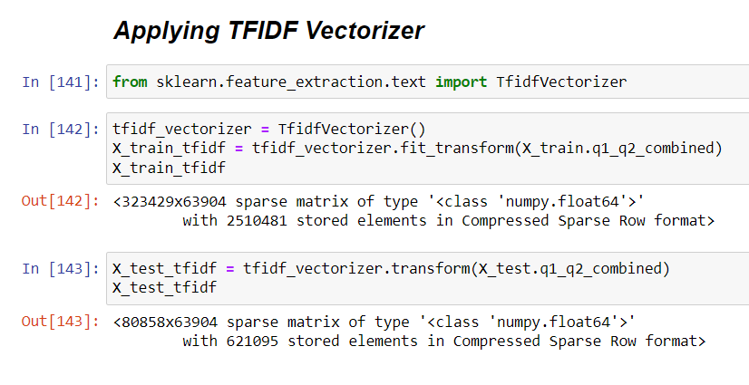
Applying TF-IDF on X_train and X_test data:

Slide 17
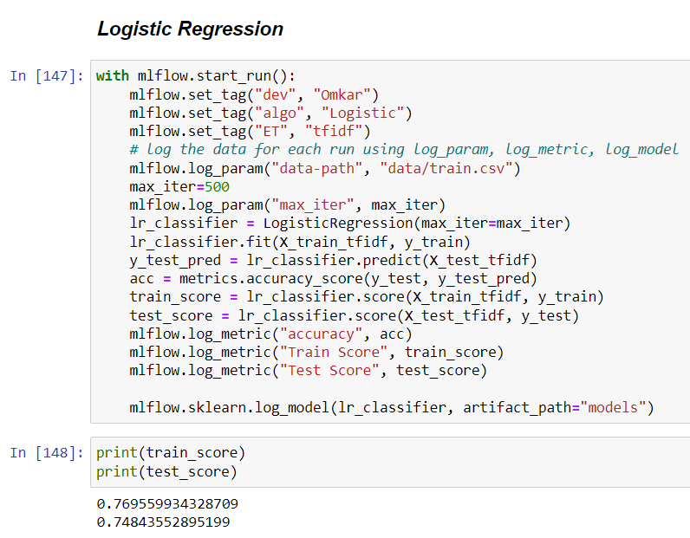
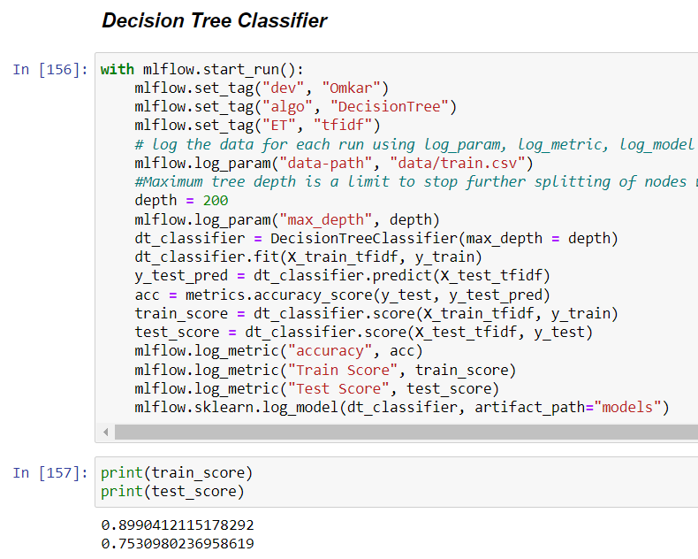
Model building and Model Evaluation with Mlflow using Logistic Regression, Decision Tree, Random Forest and XGBoost algorithms on TF-IDF Vectorization:

Slide 18
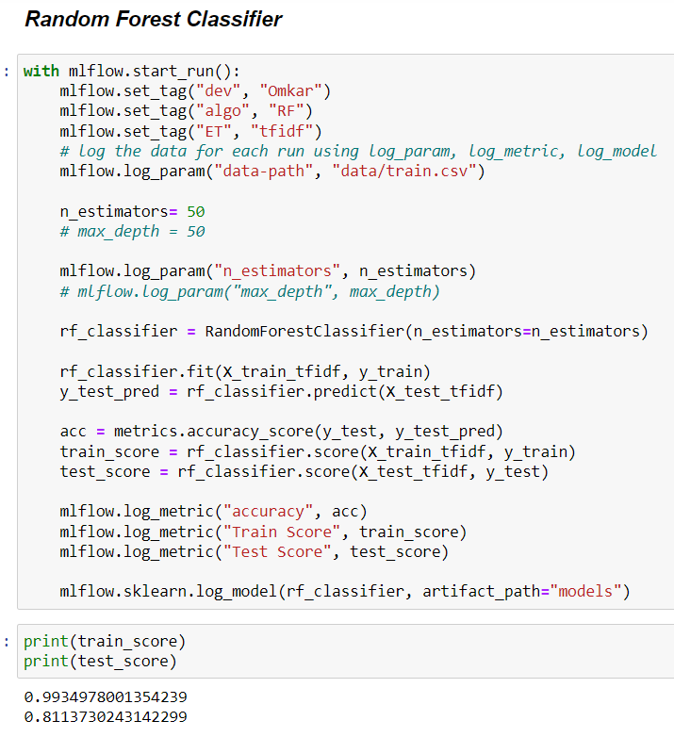
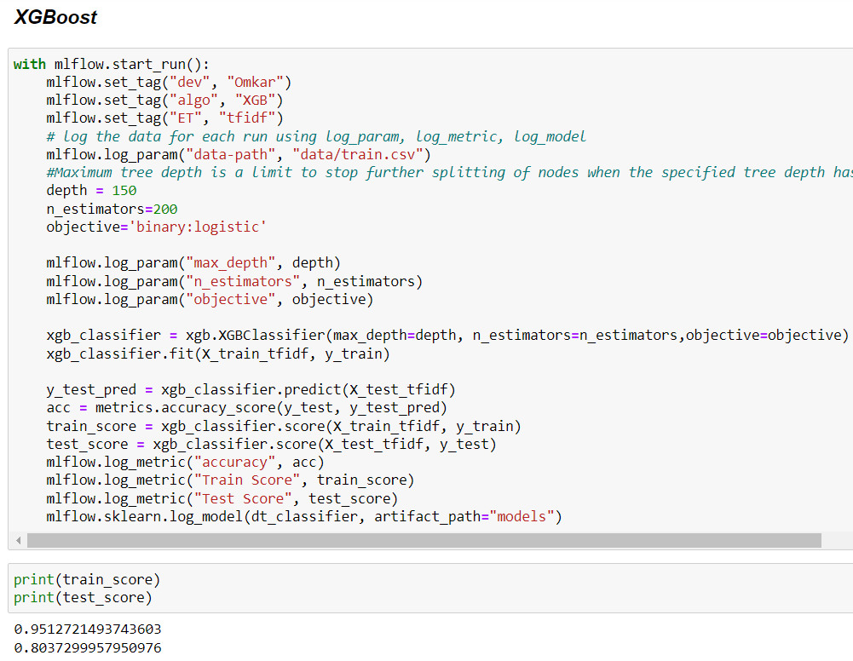
Model building and Model Evaluation with Mlflow using Logistic Regression, Decision Tree, Random Forest and XGBoost algorithms on TF-IDF Vectorization: (continued)

Slide 19
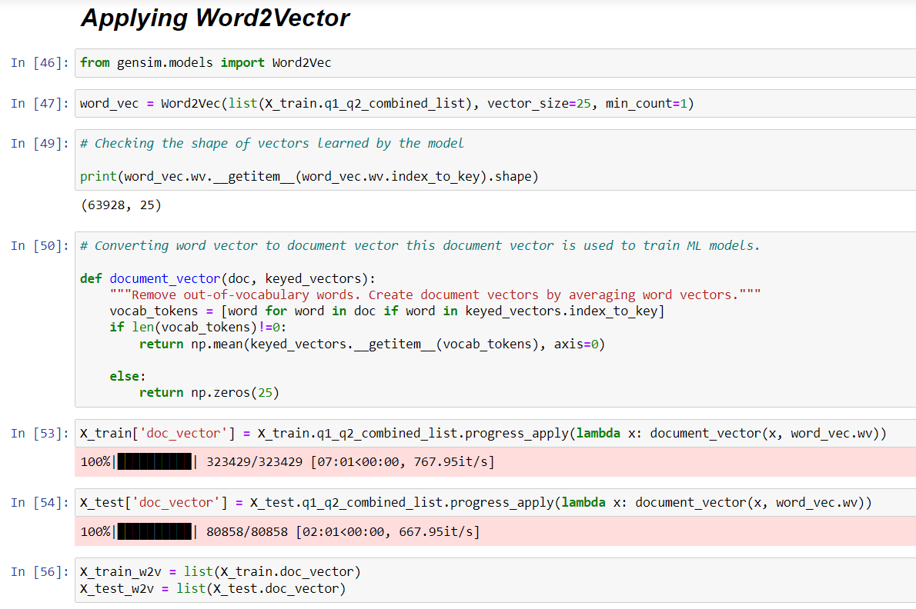
Applying Word2Vec on X_train and X_test data:

Slide 20
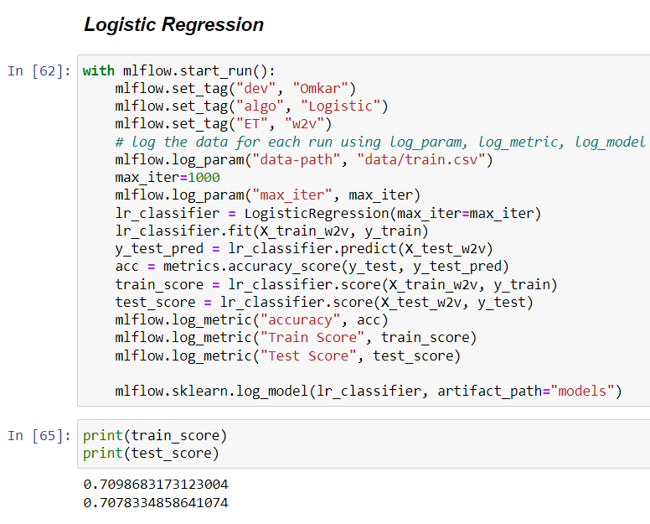
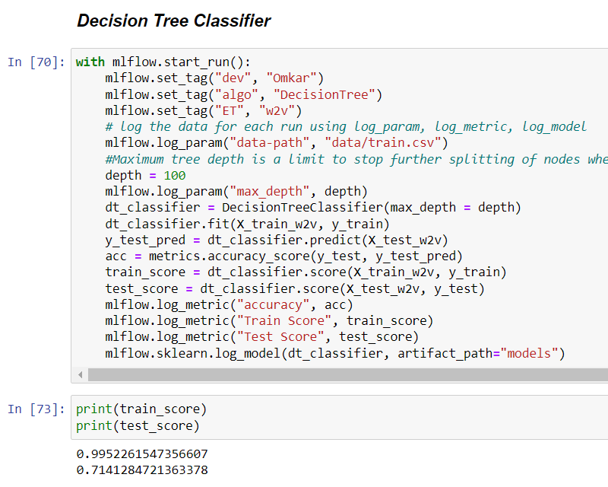
Model building and Model Evaluation with Mlflow using Logistic Regression, Decision Tree and Random Forest algorithms on Word2Vec Vectorization:

Slide 21
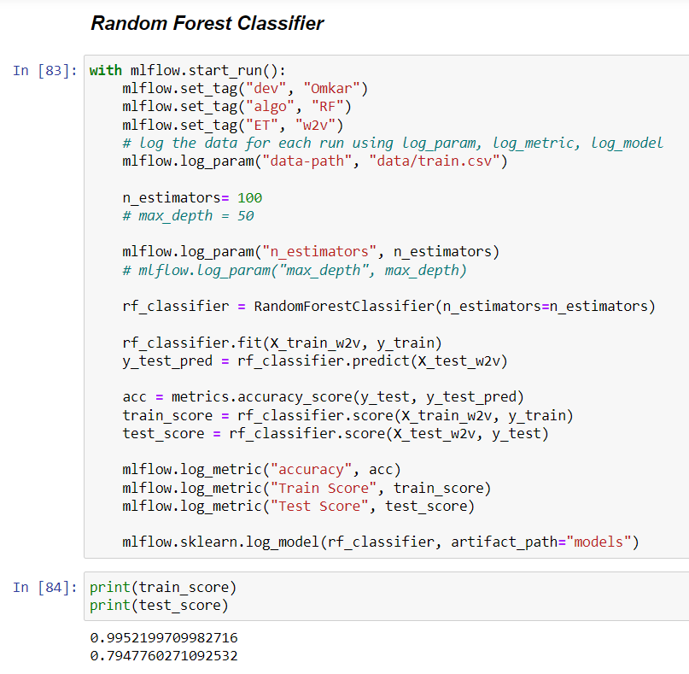
Model building and Model Evaluation with Mlflow using Logistic Regression, Decision Tree and Random Forest algorithms on Word2Vec Vectorization: (continued)

Slide 22
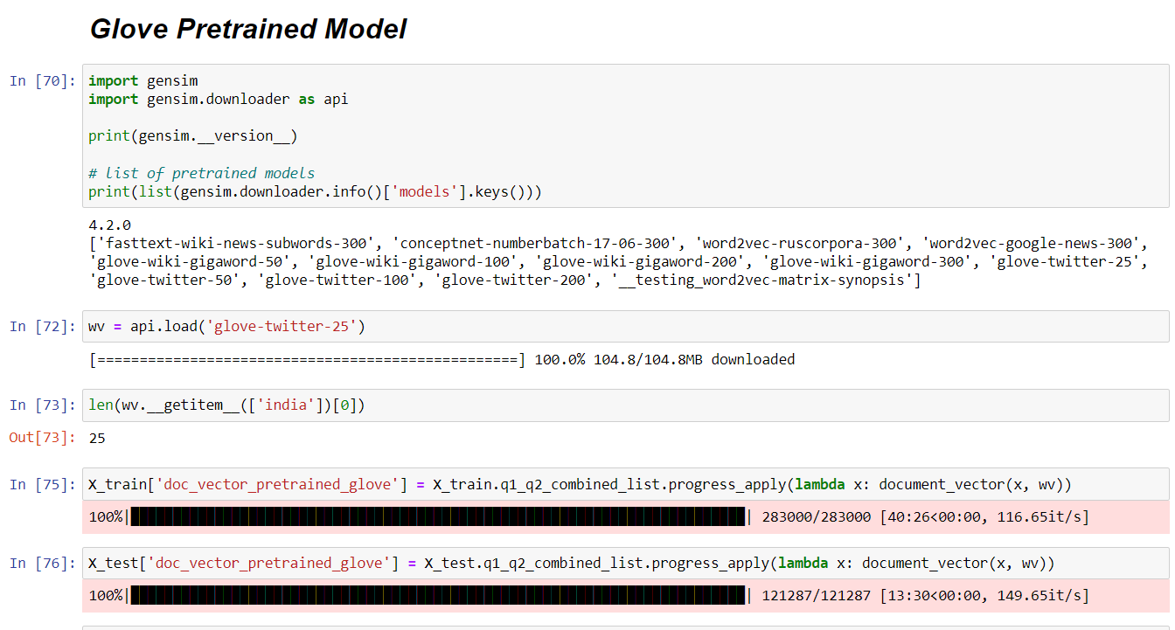
Applying Glove on X_train and X_test data:

Slide 23
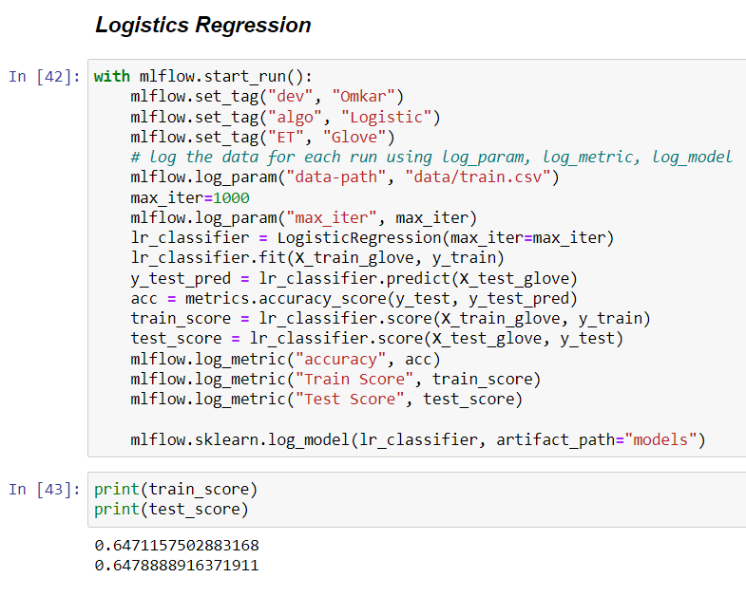
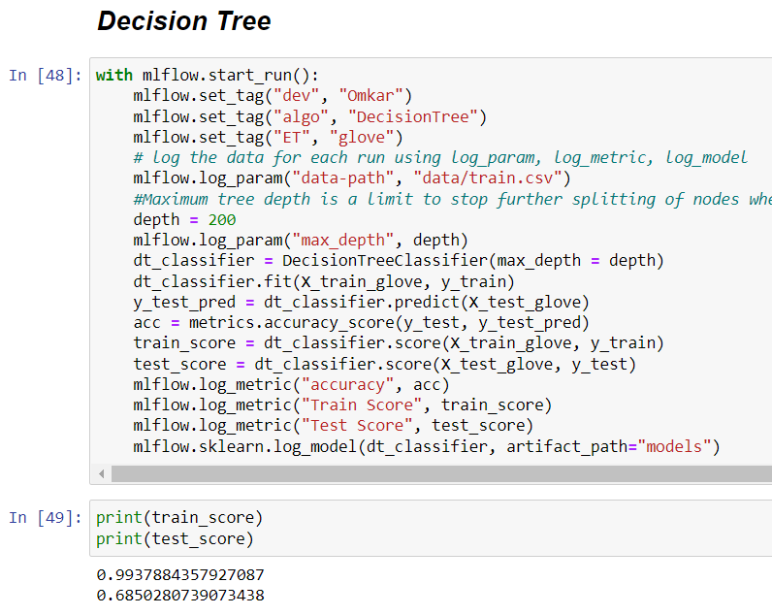
Model building and Model Evaluation with Mlflow using Logistic Regression, Decision Tree and Random Forest algorithms on Glove Vectorization:

Slide 24
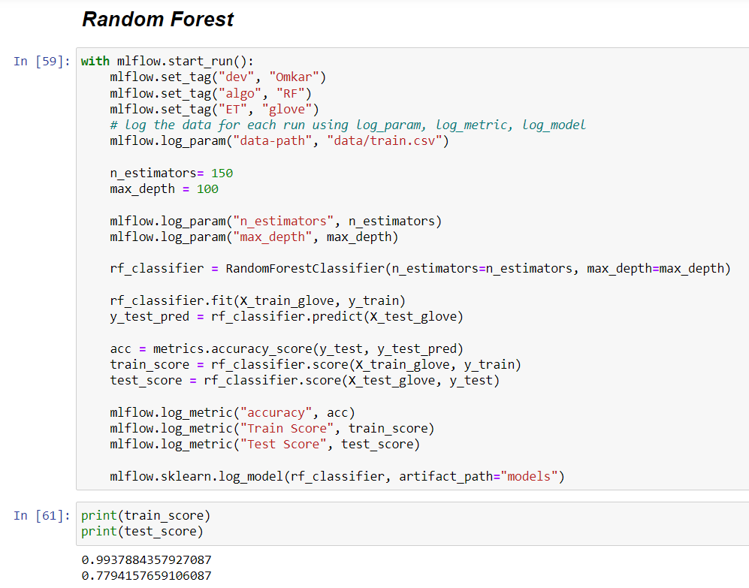
Model building and Model Evaluation with Mlflow using Logistic Regression, Decision Tree and Random Forest algorithms on Glove Vectorization: (continued)

Slide 25
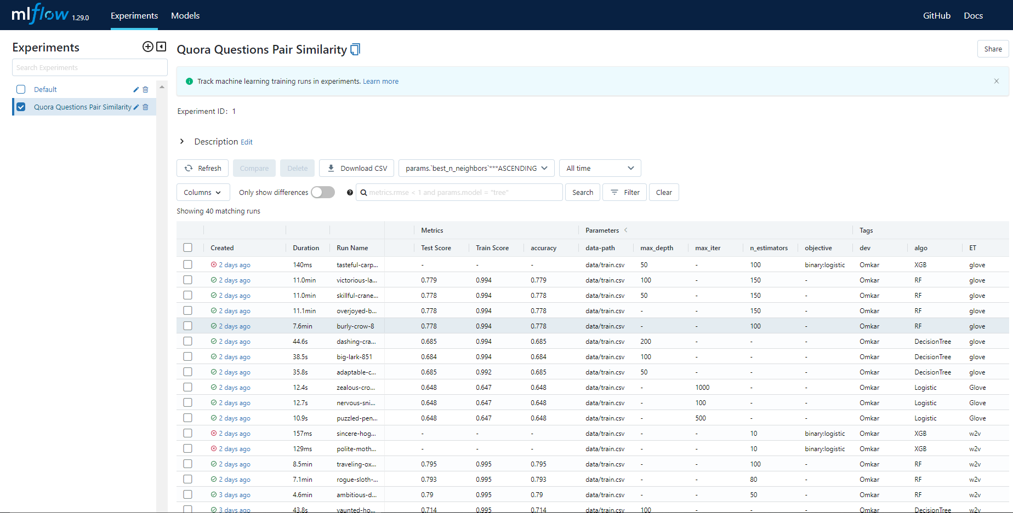
Experiment Tracking using MLflow:

Slide 26
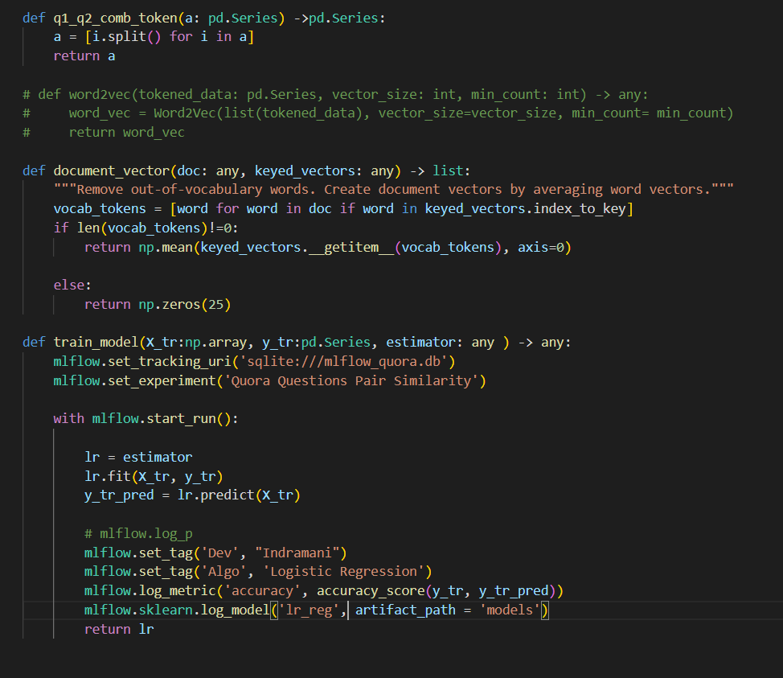
Breaking code into production ready script:

Slide 27
OBSERVATION:
According to all the Experiments which we performed on different Vectorization Techniques such as BOW, TF-IDF, Word2Vec and Glove using different algorithms.
We observed that Logistic Regression algorithm on W2V Vectorization Technique is giving the better accuracy compared to the rest of the models.
Thus, we broke our code into production ready scripts using this model.

Slide 28
FUTURE SCOPE:
This project technique is useful for any type of question answer website. The main advantage behind the project is to manage duplicate questions which help sites to free up some more space, and also can clear up the confusion and make it easier for the end user by displaying all the answers of the similar questions to the input question at a single place.

Slide 29


THANK YOU!

